Slide 1
Introduction to Machine Learning
Joy Bose
Silver Oak College
15 Feb 2020

Slide 2




What is machine learning
It is a type of computer program (input data → processing → output)
It learns from the data and adapts as more data is available
An important new concept in machine learning is model. A model is trained with historical input data. The machine learning algorithm uses the trained model to generate predictions on unseen new data.
How to decide whether to use: depends on the problem

Slide 3
Machine learning Vs traditional programming
Traditional Programming | Machine Learning
Fixed sequence of instructions + data | Adapts with new data without code change
Concept of model is hidden/ static | Generates/updates machine learning model with data
Precise, deterministic output | Output within bounds of error
Example: Rule based determination of eligibility and extraction for reader mode | Example: Eligibility and extraction based on training the model based on dataset of webpages
Driven by fixed rules | Driven by data (data is often more important for accuracy than choice of ML algorithm)
Only one step to execute | Training step + prediction step
Machine Learning
Program
(train)
Old Data
(with/without
labels)
Model
Instructions
Traditional Computer Program
Output
Data
Updated Model
Machine Learning
Program
(predict)
Output Predictions
New Data

Slide 4
What is machine learning: Supervised
1. TRAINING
2. PREDICTION
Prediction
(personalization)
App
(e.g. browser)
Collect data
with labels
Data
(multiple users)
Train using
ML Algo
(SVM, NN,
decision tree)
Machine learning model
Machine learning model
App
(e.g. browser)
Data
User activity data 🡪
URLs browsed
Context (location, time)
Training can be done in the server
Mostly done on the client device
(smartphone, PC)

Slide 5

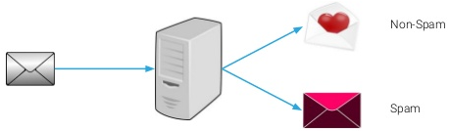
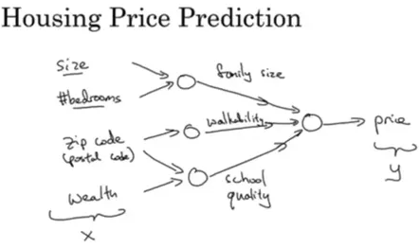
What is machine learning: Supervised
Two types of supervised ML
Classification: output is a predicted class for the input data (e.g. Email spam/ham, India/US, male/female, age range, income bracket)
Regression: output is a predicted value (e.g. stock market, house prices, user’s preferred setting value)

Slide 6
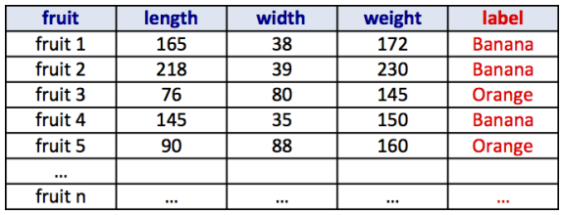
Example dataset
Features

Slide 7
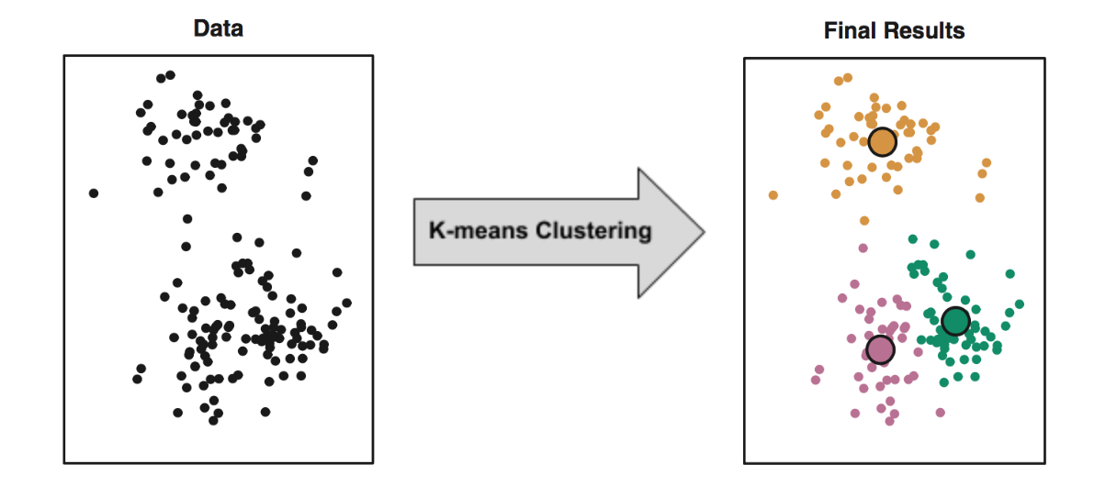

What is machine learning: Others
Unsupervised: Find patterns in data (clustering history to get interests), find outliers in form filling, anomalies in browser/app usage logs
Reinforcement learning: Decide action in response to data. Adapt model based on reward out of interaction with environment. E.g. robot move with obstacles

Slide 8
Steps in supervised machine learning
Input data
Preprocessing
Preprocessing : data cleaning, bigrams etc
Input dataset: data, labels
Split input dataset → training set, validation set, test set (e.g. 70/15/15 split)
Train machine learning algorithm on the training set
Predict labels using the trained model
Tune the parameters and validate to get max accuracy on the validation set
Test on unseen data: test set
Prepare dataset
Training
Prediction
Validation

Slide 9
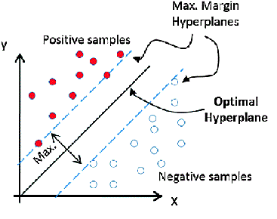
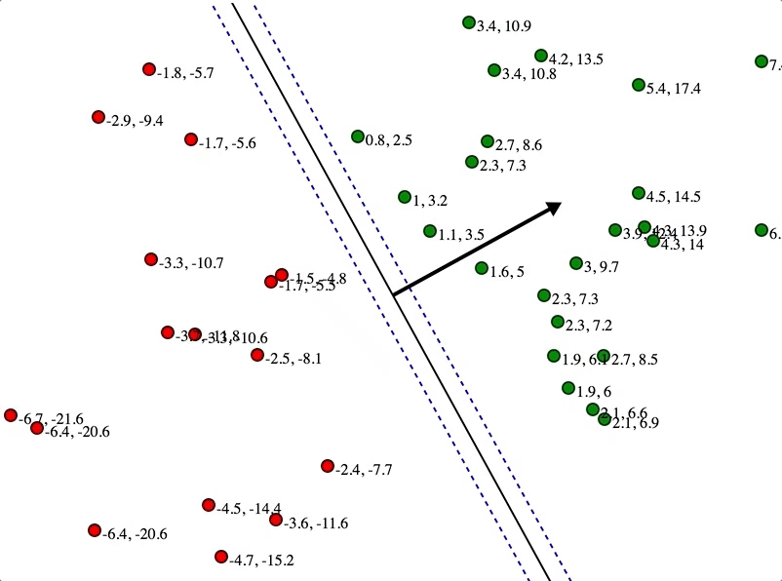
ML Algorithm: Support Vector Machine
Used for Classification where labels are available
Constructs an optimal hyperplane to maximize the gap between data points (support vectors) from the two classes
May need to cast input data into high dimensional space to make it linearly separable

Slide 10
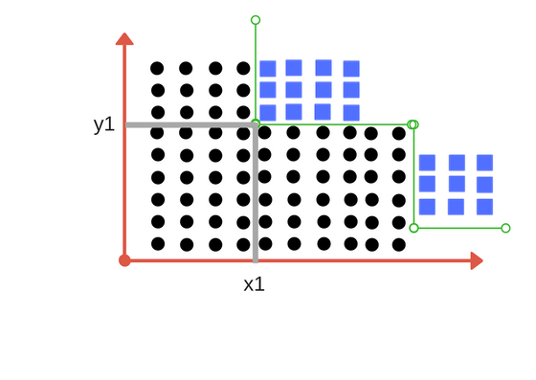
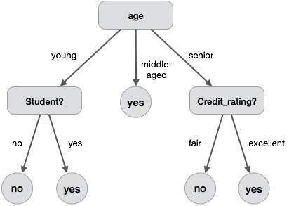
ML Algorithm: Decision tree
Used for classification where labels are available
To classify the input data, it constructs a tree where each branch is a decision, based on max entropy gain

Slide 11

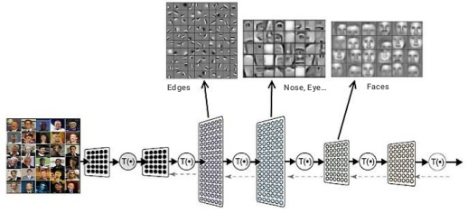
ML Algorithm: Neural Network
Multiple layers of artificial ‘neurons’, each neuron performs a summation of its inputs and fires an output value, which is input to the next layer
Modern incarnation: Deep learning

Slide 12
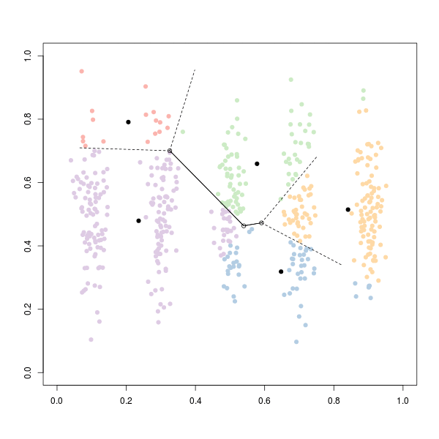
ML Algorithm: K means clustering
Unsupervised learning from data (no labels)
Must know number of clusters K in advance
Set random K points, find distance of each data from nearest and join to that cluster, calculate centroids, repeat

Slide 13

Metrics to measure accuracy
Precision
How many selected items are relevant
TP/(TP+FP)
Recall
How many relevant items are selected
TP/(TP+FN)
Accuracy
How many are correctly classified
TP+TN/Total

Slide 14
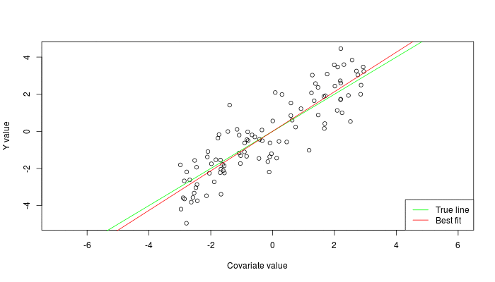


Labeled Data
Machine Learning algorithm
Training
Prediction
Labeled Data
Learned model
Prediction
class A
class A
Classification
Regression
Clustering

Slide 15
Introduction to Deep Learning
Deep Learning is just a new name for deep neural networks
These models have proven to have better accuracy than others on common tasks
Especially popular for computer vision applications

Slide 16


Slide 17
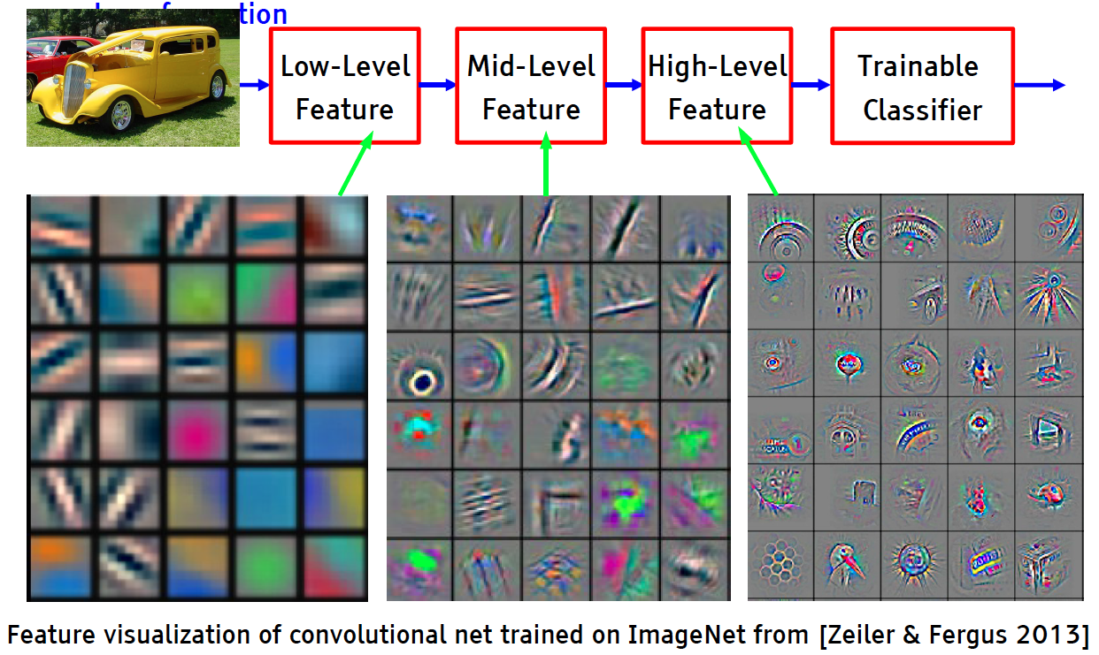
Deep Learning: Hierarchical representations
‹#›

Slide 18
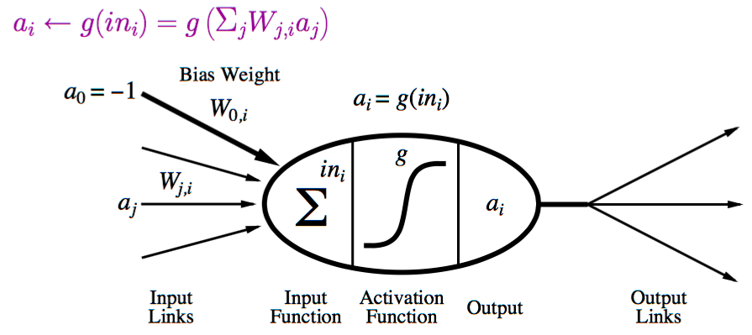
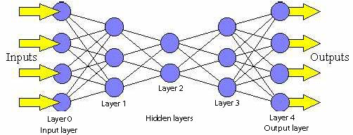
Neural Network
Layers of neurons
Each neuron sums the inputs and applies a nonlinear function

Slide 19
Where ML model runs
Option 1: Purely on server
Need to maintain service
Pro: More accuracy, relevance
Con: latency, loss of data privacy
Option 2: train on server, run on client device
No need to maintain service
Pro: faster (no need to load again), privacy
Con: model size, eat up memory and computation, updates needed
Option 3: Purely on client
ML code is part of the executable
Pro: no need to contact server, can be fastest if small and simple model, privacy
Con: Eat up resources (esp in small devices such as smartphones)

Slide 20
Running ML as a service
Problems
Edge extensions have data constraints (200 KB)
ML models can be huge (10s of MBs)
Solution: ML services
Fast servers can run the ML algorithm
Run from the web browser as a service
Browser uploads data to the server and gets quick results
No memory and resource constraint on client device.
Main issue is communication latency
(such as : using Azure ML)

Slide 21
ML tools/Resources
Common languages: Python / R, may ML libraries exist (versions can be found in C++ on github also but latest libraries in Python are easily available)
Platforms: Azure Machine Learning Studio, Jupyter notebook
Algo/Models: Deep learning, SVM, decision tree, random forest, LDA, k-Means, association rules
Toolkits: CNTK (Microsoft Cognitive Toolkit), scikit-learn, NLTK (NLP related), Caffe, TensorFlow, keras, fast.ai
Datasets/ problems: Kaggle, UCI datasets, AWS public datasets, MSR OpenData
Github, data science central, arxiv.ML, KDNuggets, Analytics Vindhya, Kaggle

